Slide 1
“CGI is an “ancient” technology. Is CGI obsolete? What are the possible alternatives to CGI? At the very least you should explain what is Fast CGI, what is PHP, what is the difference between PHP and CGI. You should also explain clearly what is Javascript, Java Servlets, JSP, what exactly are their differences and emphasize on explaining server-side and browser-side applications.”

Slide 2
Contents
CGI
Fast CGI
PHP
Difference Between PHP and CGI
JavaScript
Java Servlets
JSP
Differences on Server-side and Browser-side

Slide 3

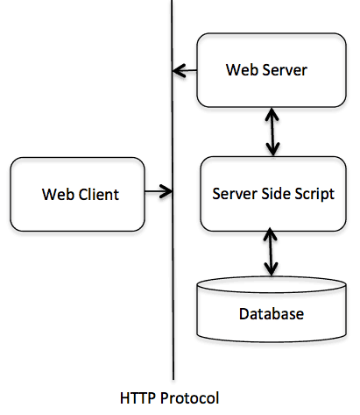
What is CGI?
Common Gateway Interface (CGI) is a standard method used to generate dynamic content on Web pages and simple Web applications.
CGI runs on a Web server like APACHE. It basically provides an interface between the Web server and programs that generate the Web content.
Programming languages or scripts, which are use to generate web contents are known as CGI scripts or simply CGIs. These scripts can be written in PHP, PERL, C, C++, JAVA and Python.

Slide 4
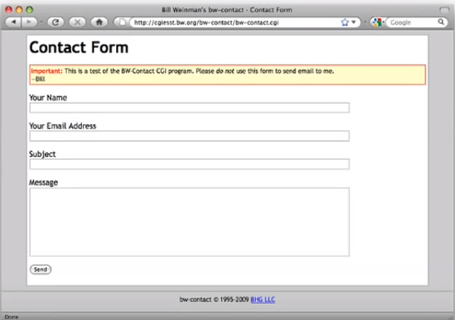
So when you see a web form like this one, you fill it in and you press the “Send” button, what happens from this point is the web browser submits the data to server, the server passes the data on to an application. The application responds and it goes back up the chain, back to your web browser and your web browser gets some kind of result.

Slide 5
Is CGI obsolete now?
CGI for web applications may appear simple and easy, but it is slow, clumsy, insecure and ancient.
The “obsolete”-ness of CGI is really only a factor if you are doing big, complex sites with lots of page views.
Yes! There are much better alternatives for nearly every use case.
Issues with CGI
-Costly
-Slow/Unresponsive
-Vulnerable/Unsecure
-Low Level
-Less Scalable

Slide 6
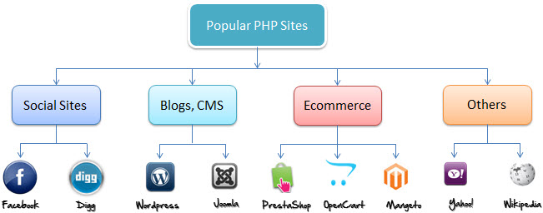
Alternatives
Fast CGI
Fast CGI is a program that manages multiple CGI requests within a single process, saving many program instructions for each request. According to one Fast CGI implementor, user requests coming to a Web site can be handled 3 to 30 times faster using Fast CGI. It is a plugin to the Web server.
PHP
An acronym for “Hypertext Preprocessor”, PHP is an open source and free, server side scripting language, that is used to develop Static websites or Dynamic websites or Web applications.

Slide 7
Difference between PHP & CGI
PHP
Programming language that is common in the scripting of Web application code
Comes with some pre-written module used for a wide variety of purposes (not just generating web pages)
CGI
Not a programming language but rather an interface to the system.
Allows for an interface that comes to the system using a script or executable file of which may be C, C++, Perl, and similar languages

Slide 8
Javascript
It is a programming language, supported by almost every web browsers. Primarily used to enhance web pages to provide for a more user friendly experience. These include dynamically updating web pages, user interface enhancements such as menus and dialogue boxes, animations, 2D and 3D graphics, interactive maps, video players, and more.
Java Servlets
Servlets are the Java programs that runs on the Java-enabled web server or application server.
Used to handle the request obtained from the web server, process the request, produce the response, then send response back to the web server.
JSP (Java Server Pages)
It’s a text document, contains two types of text: static data, expressed in any text-based format (such as HTML), and JSP elements, which construct dynamic content.
It’s used to create web application just like Servlet technology.
Works as an extension to Servlet because it provides more functionality than servlet such as expression language, JSTL, etc.

Slide 9
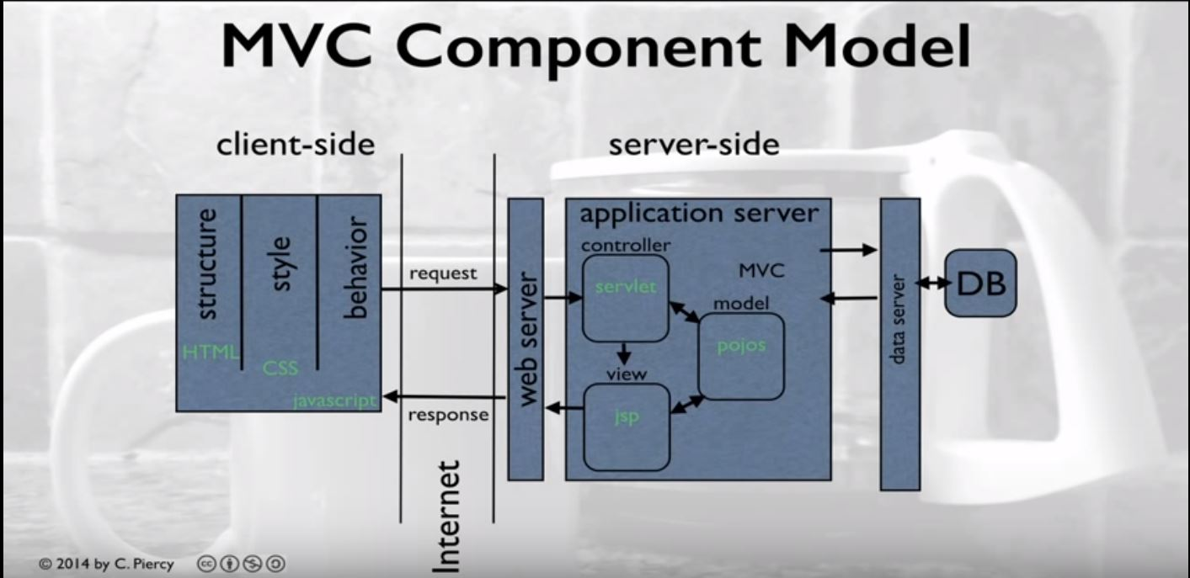
MVC Component Model Implemented in JAVA
When MVC (Model-View-Controller) based web-application design pattern is implemented in JAVA, we use the components like JavaScript, Servlet and JSP

Slide 10
Client Side and Server Side Applications
Client Side
The client side would be something that would appear in the web browser
Technologies like HTML is used to handle Structure, CSS for Style and JavaScript for Behaviour.
Used to generate request and display result.
Server Side
Here we have a web server which will handle the traffic coming in from client.
The servlet (controller) will get the request and handle that using classes as needed.
All the information is processed by model and jsp will create the view and send back the response.

Slide 11
Thank You!
Lakshya Sahai
Kartik Nagarajan
Pranab Singh
Vipul Pawar

